Slide 1
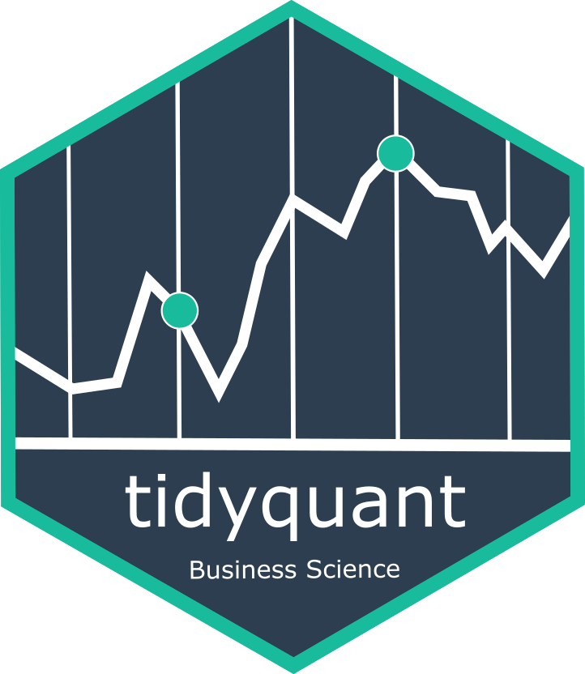



New tools for performing financial & time series analysis within the “tidy” ecosystem
EARL San Francisco, 2017
Matt Dancho Founder, Director of Product Development mdancho@business-science.io | Davis Vaughan Software Engineer dvaughan@business-science.io
@bizScienc
www.business-science.io

Slide 2
Program
Act 1: Financial analysis at scale
Act 2: Time series machine learning
Act 3: Enterprise applications

Slide 3
Act 1: Financial analysis at scale
Discuss existing financial analysis landscape
Why tidyquant?
The five core tq functions
Data science at scale

Slide 4
Financial analysis landscape
xts
zoo
Quantmod
& TTR
PerformanceAnalytics
Infrastructure well-developed for Financial Analysis
Many useful functions
Data transformation
Financial analysis

Slide 5
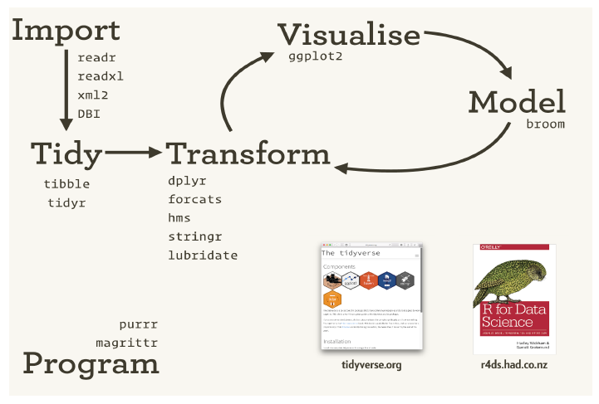
Data science in the tidyverse
Infrastructure well-developed for Data Science
Useful workflow
H. Wickham, 2017. URL https://www.rstudio.com/resources/videos/data-science-in-thetidyverse/. [p2]

Slide 6
Two systems: Each with benefits
xts
Built for speed
Matrix-based
Wide format
Only numeric columns
tidyverse
Built for flexibility & scale
Data frame-based
Long format
Any data type in columns
char, num, list

Slide 7
tidyquant: Best of both worlds
Integrates tidyverse with:
xts & zoo
quantmod & TTR
PerformanceAnalytics
User I/O in data frames
Internally converts to xts
Matrix speed + Data Frame flexibility
Tidyverse scalability

Slide 8
Five core functions
Import
tq_get
Transform
tq_transmute & tq_mutate
tq_portfolio
Model
tq_performance

Slide 9
What does scalability look like?
1 Asset | 500 Assets
tq_get(“AAPL”) 1 asset X 10 years = 2520 daily obs. | tq_index(“SP500”) %>% tq_get() %>% group_by(symbol) 500 assets X 10 years = 1.26M daily obs.

Slide 10
What does scalability look like?
tq_index(“SP500”) %>%
tq_get() %>%
group_by(symbol) %>%
tq_transmute(adjusted,
mutate_fun = periodReturn,
period = “daily”,
type = “log”,
col_rename = “dlr”) %>%
summarize(MDLR = mean(dlr),
SDDLR = sd(dlr))
Get
Transform
Model / Analyze

Slide 11
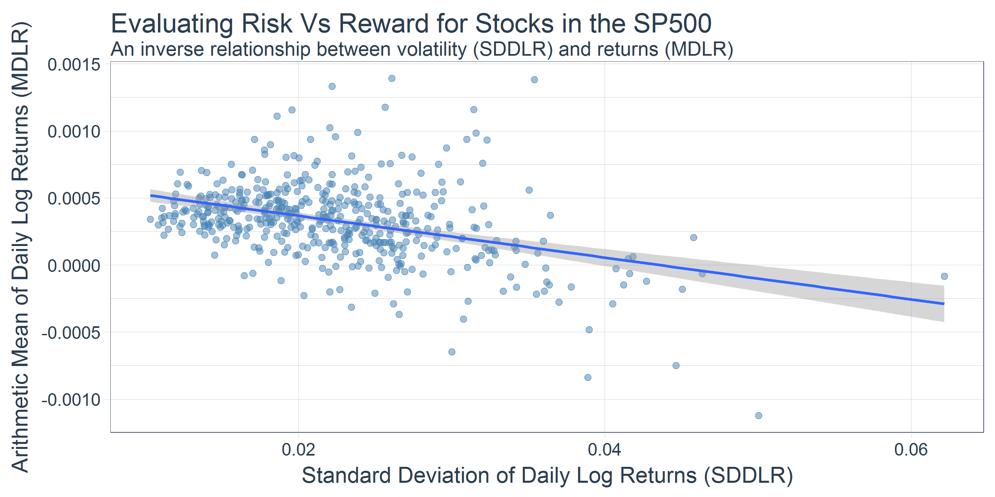
Trending MDLR & SDDLR - All S&P500 Stocks

Slide 12
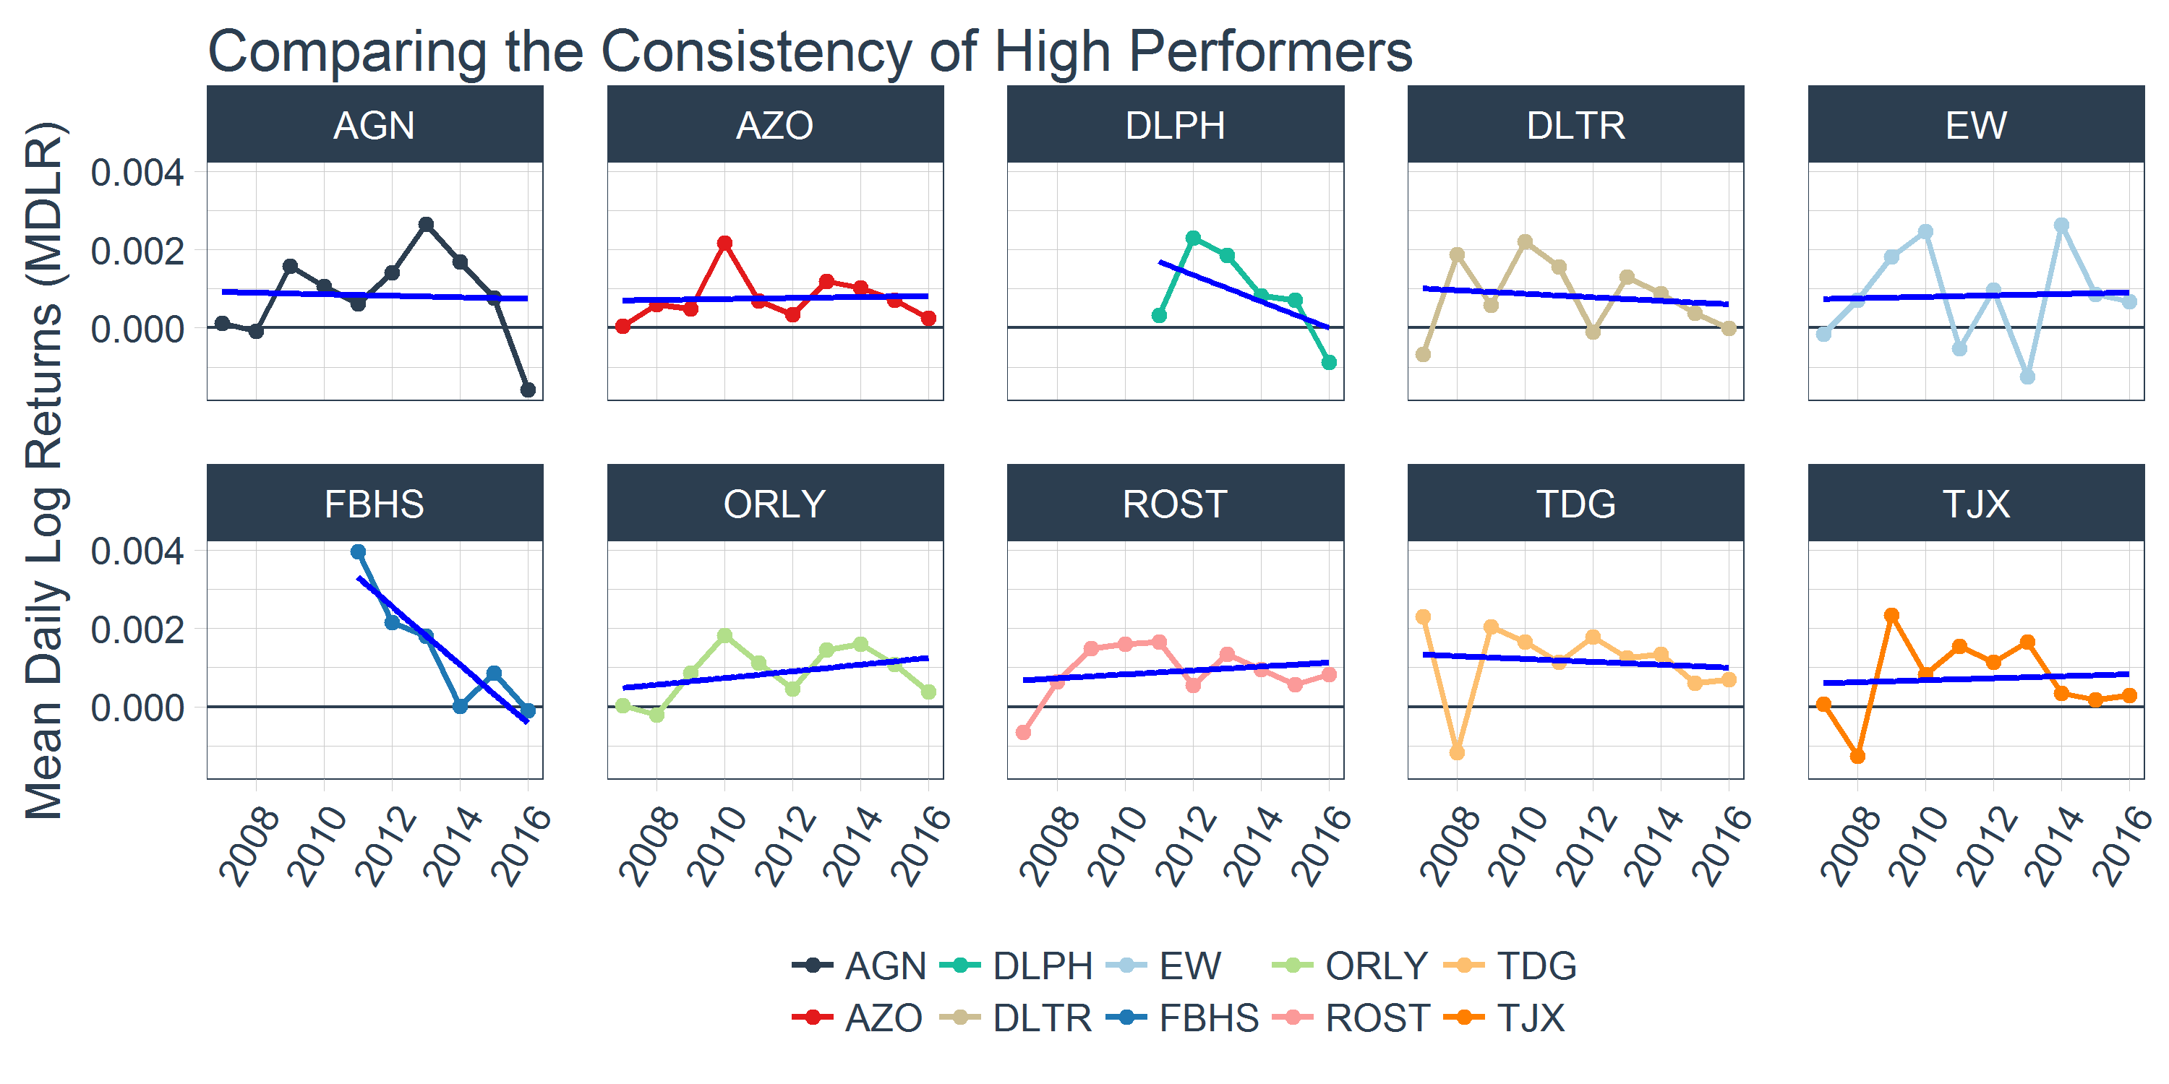
Extending analysis to MDLR by year

Slide 13
Act 2: Time series machine learning
Existing forecasting package landscape
timekit: A different approach
Core tk functions
Time series machine learning

Slide 14
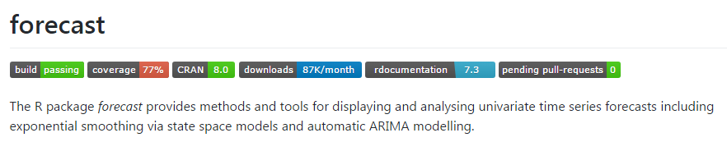
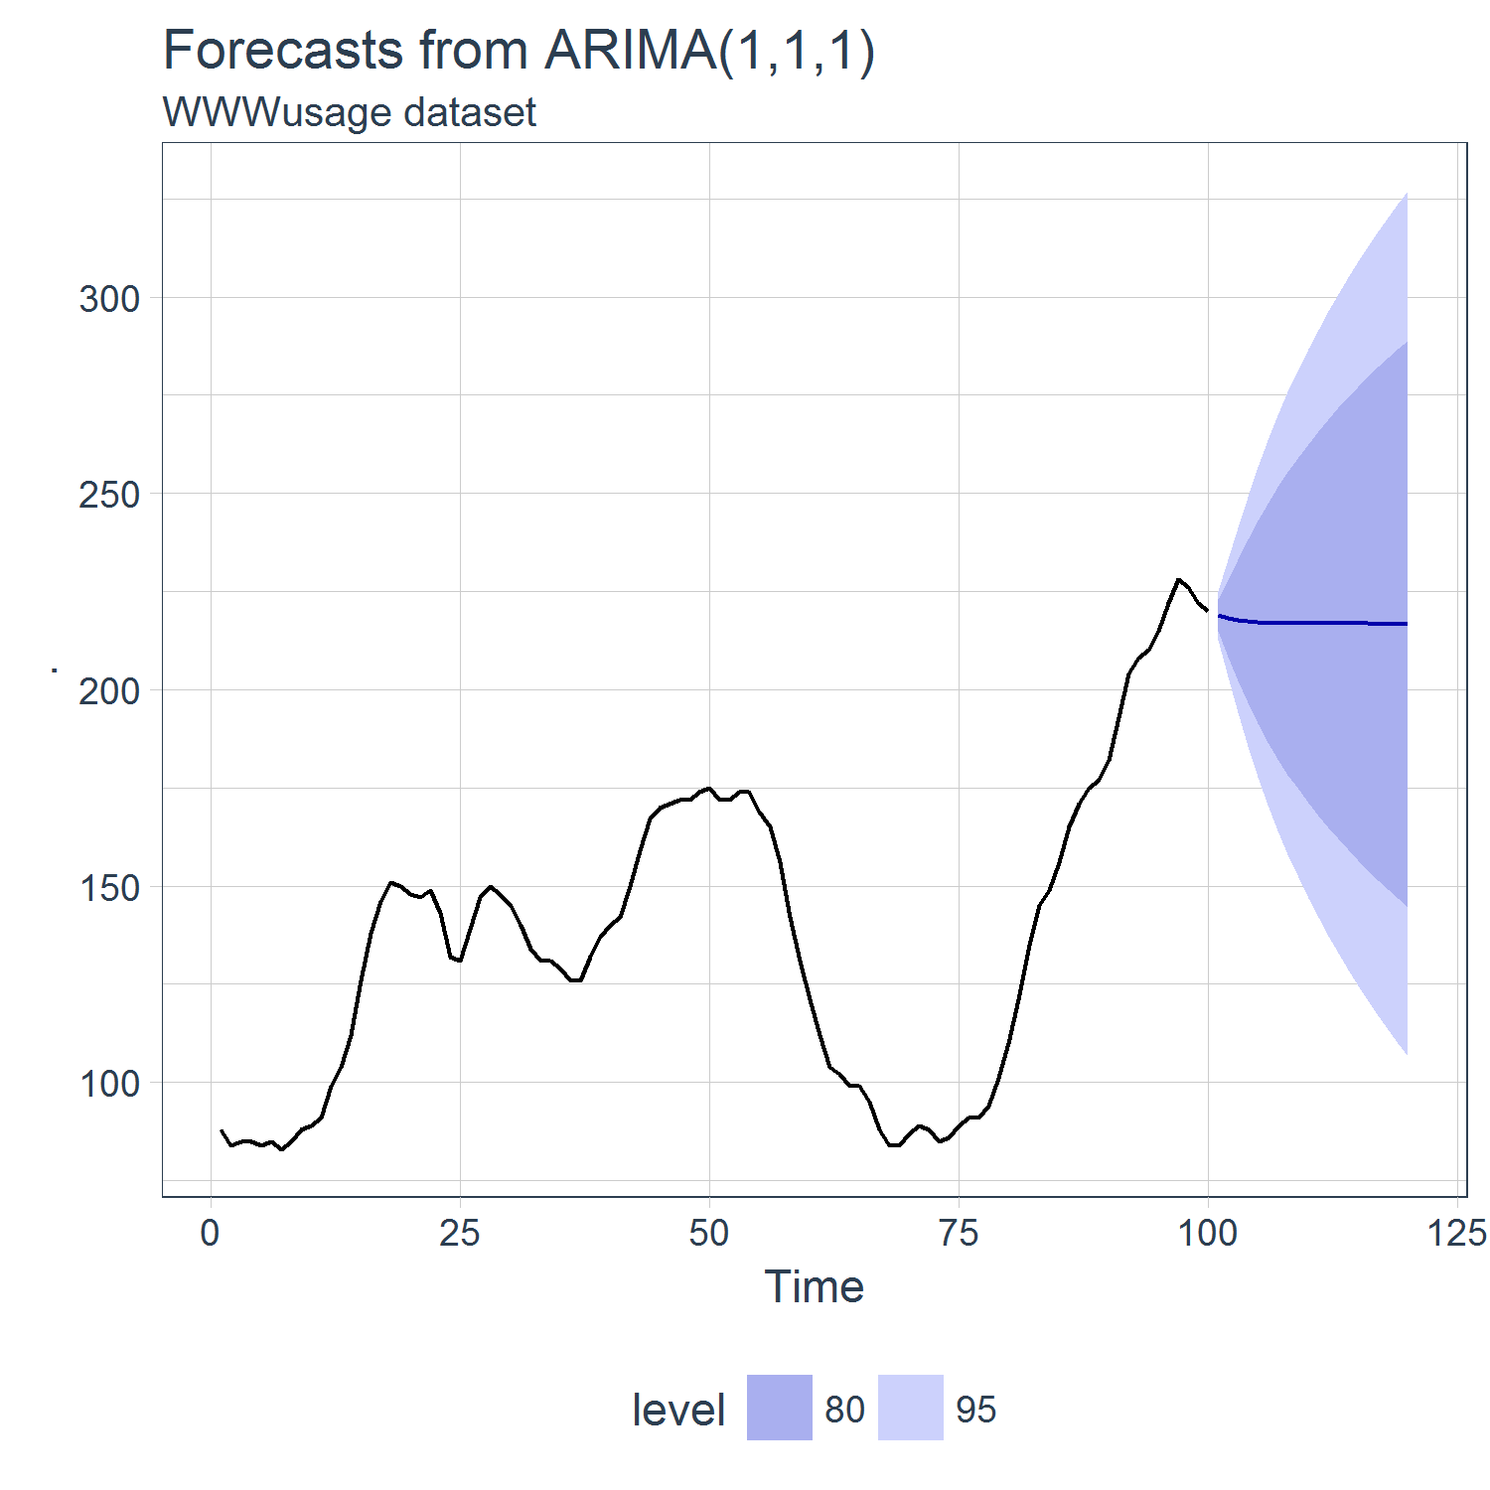
forecast package
Pros:
Accurate, time tested, highly flexible, latest techniques
Cons:
Dependent on regularized ts class
Not suited for higher frequency (daily & sub-daily)
Difficult to implement external predictors (xreg)
Closed box
100 obs, second frequency

Slide 15
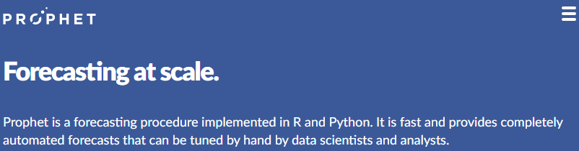
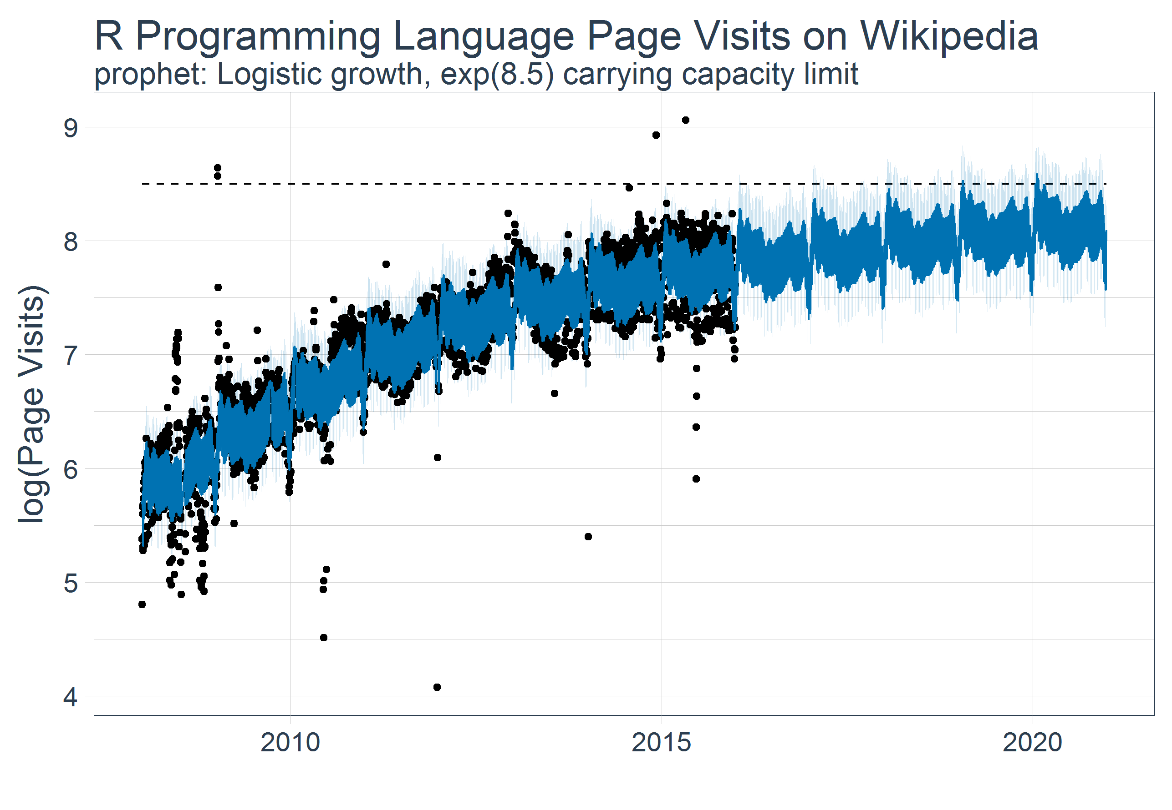
prophet package
Pros:
Easy to use, great documentation
Good with daily frequency data
Implemented in R & Python
Uses data frames
Cons:
Not for high frequency data
Currently cannot implement external predictors (v0.2 feature)
Closed box
2863 obs, daily frequency

Slide 16
timekit: A different approach
Enables open box time series modeling
Designed for machine learning using a time series signature
Uses the data science workflow:
Model > Train > Test > Predict > Visualize

Slide 17
Four core tk functions
tk_get_timeseries_signature()
Transform
Extract
tk_index()
tk_make_future_timeseries()
tk_get_timeseries_summary()

Slide 18
Time series machine learning
A lot of info in a timestamp
Day, week, month, year, hour, min, sec, …
Day of month, quarter, year, …
Bi-weekly, tri-weekly, …
First week of the month, second week, …
Machine learning possible using engineered features

Slide 19
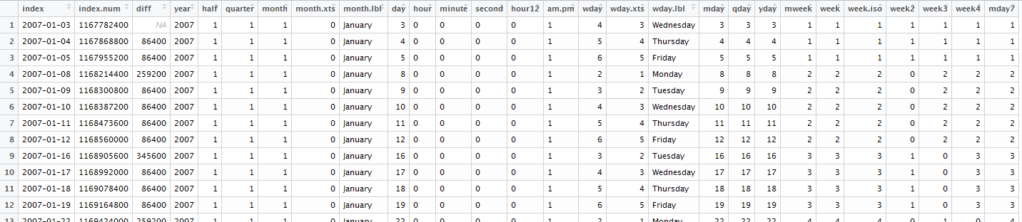
Time series signature
data %>%
tk_index() %>%
tk_get_timeseries_signature()
index
Signature

Slide 20
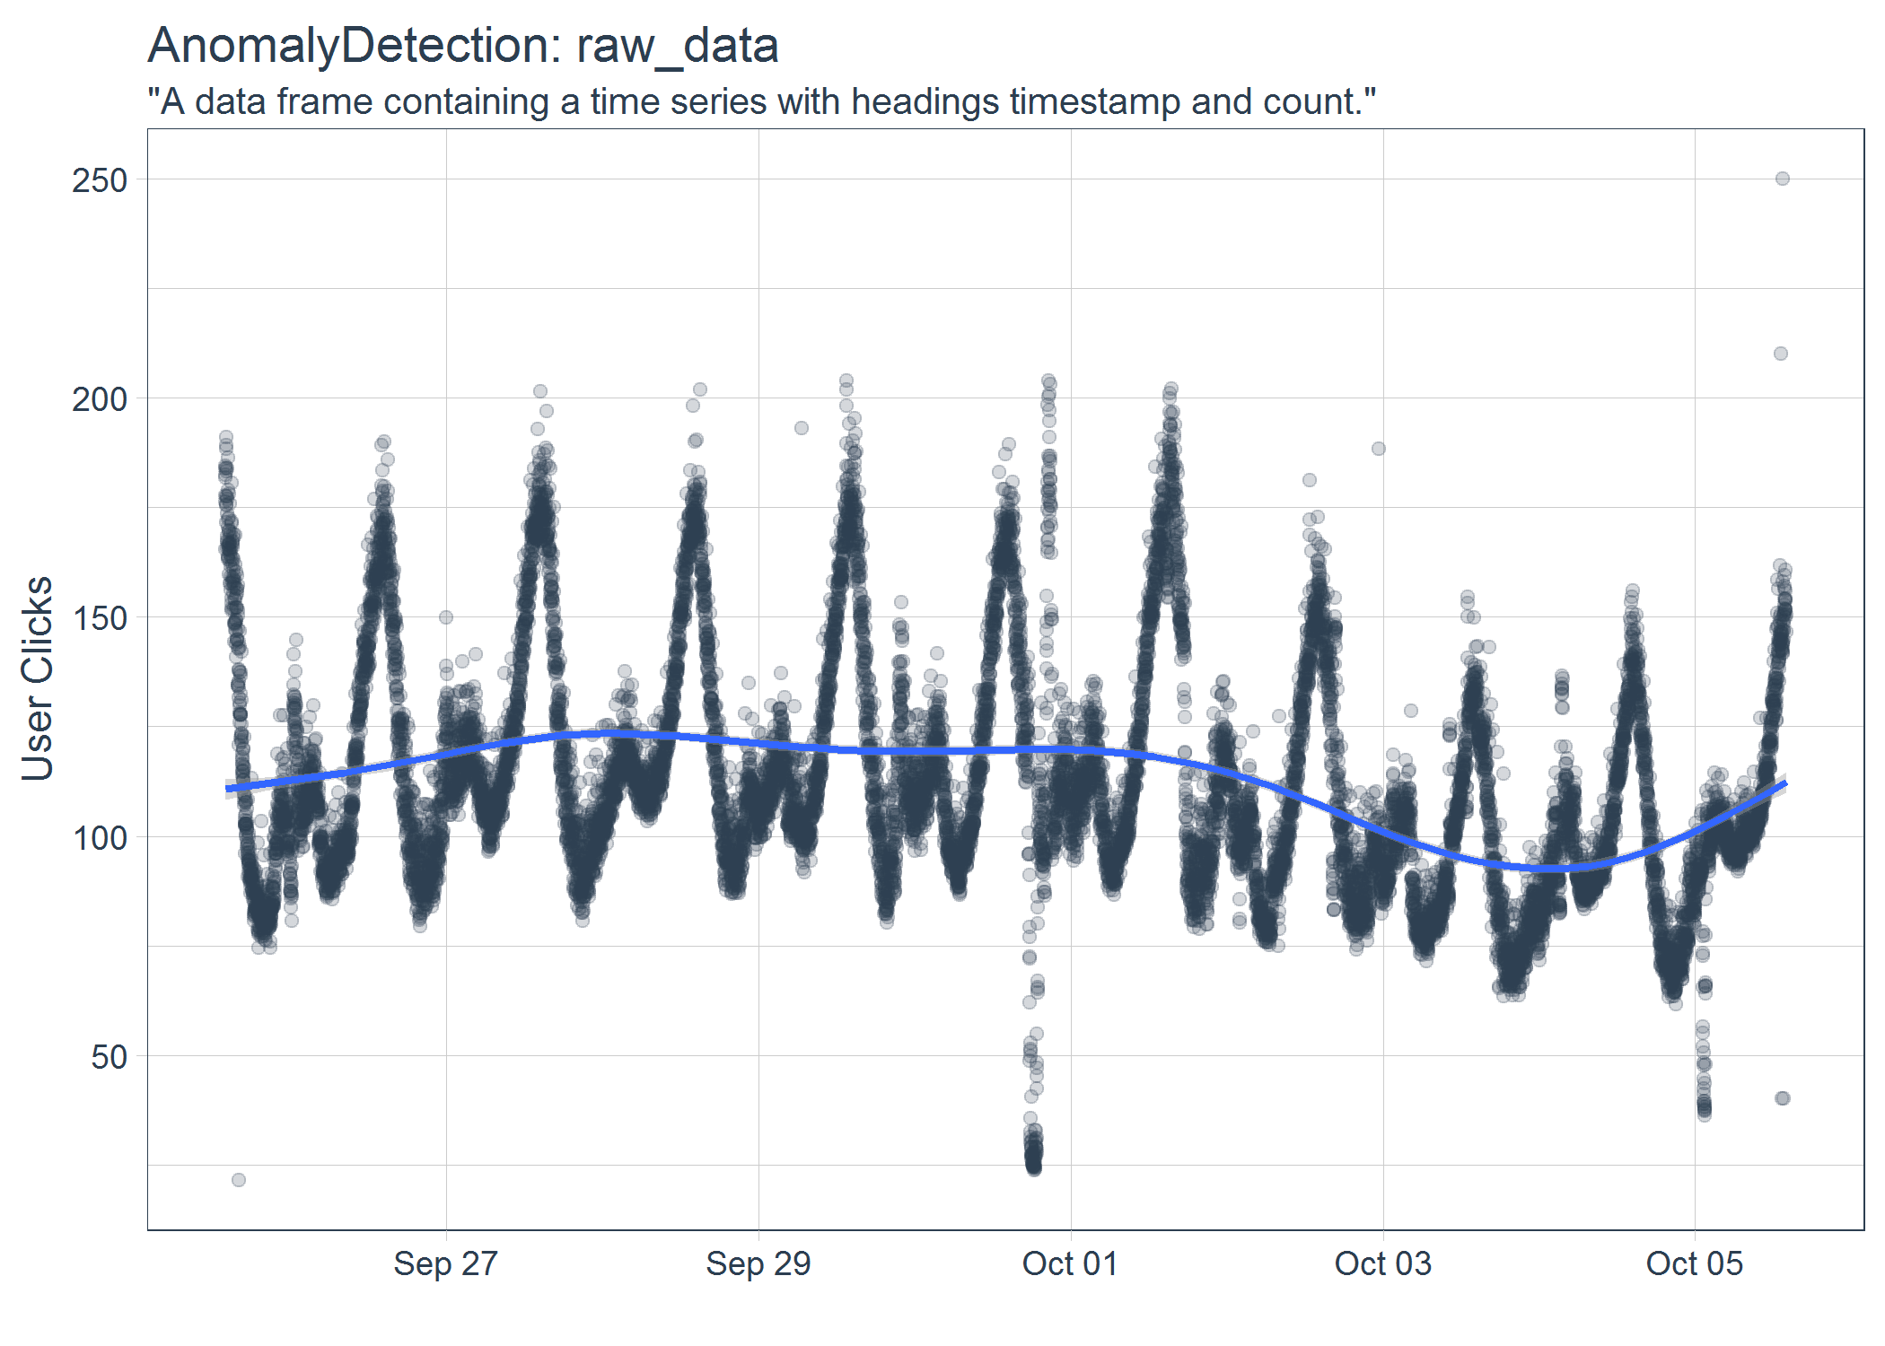
High frequency forecast: Minute frequency
Example:
Data: Twitter user clicks from AnomalyDetection package
Model: 14,398 observations spanning 10 days at 1 minute frequency
Forecast: Next 4000 observations
AnomalyDetection package: https://github.com/twitter/AnomalyDetection
User clicks data by minute
data(raw_data)

Slide 21
High frequency forecast: Minute frequency
Traditionally very difficult:
forecast: ARIMA not possible
prophet: 10+ minutes, result was incomprehensible
timekit: ~30 seconds, excellent results

Slide 22
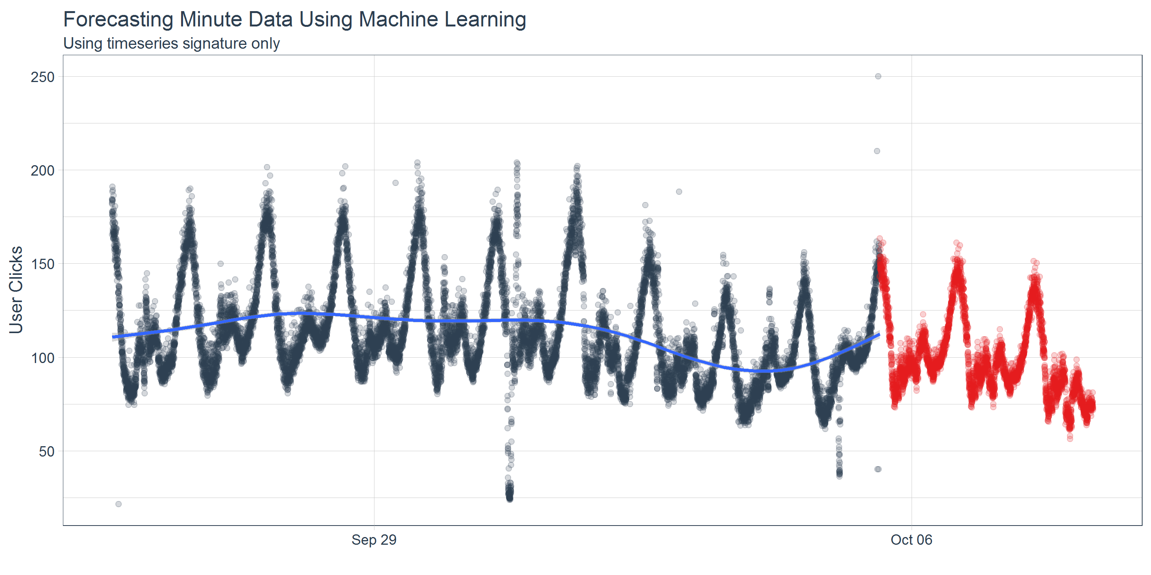
timekit 1st attempt: ML Only
rmse_train = 10.45
ML algorithm detects pattern
Misses trend slightly

Slide 23
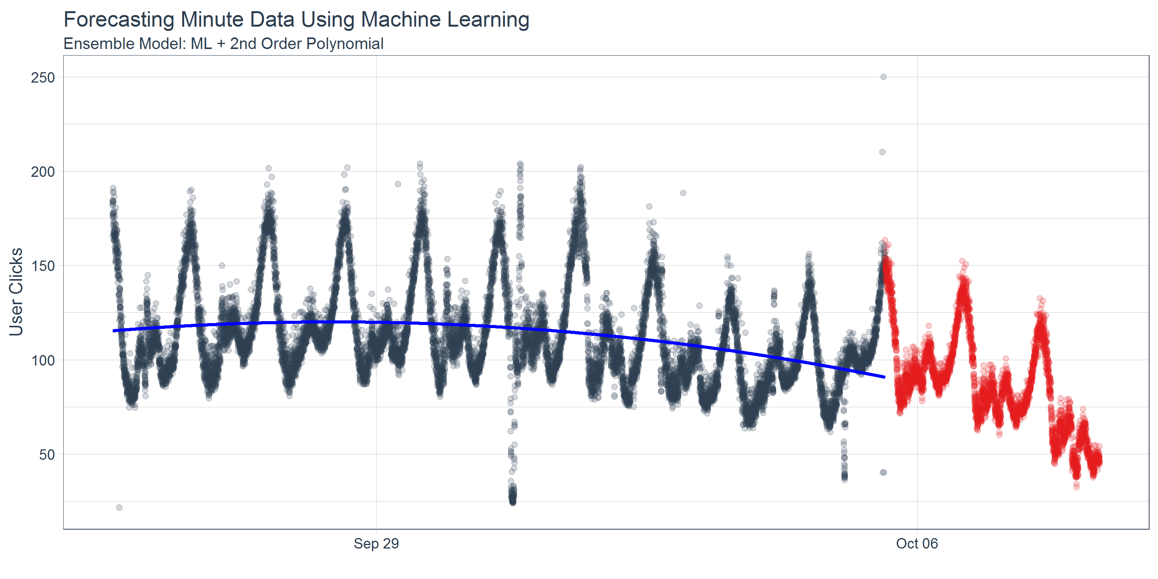
timekit 2nd attempt: ML + 2nd Order Poly
Ensemble gives a support
2nd order polynomial really misses trend

Slide 24
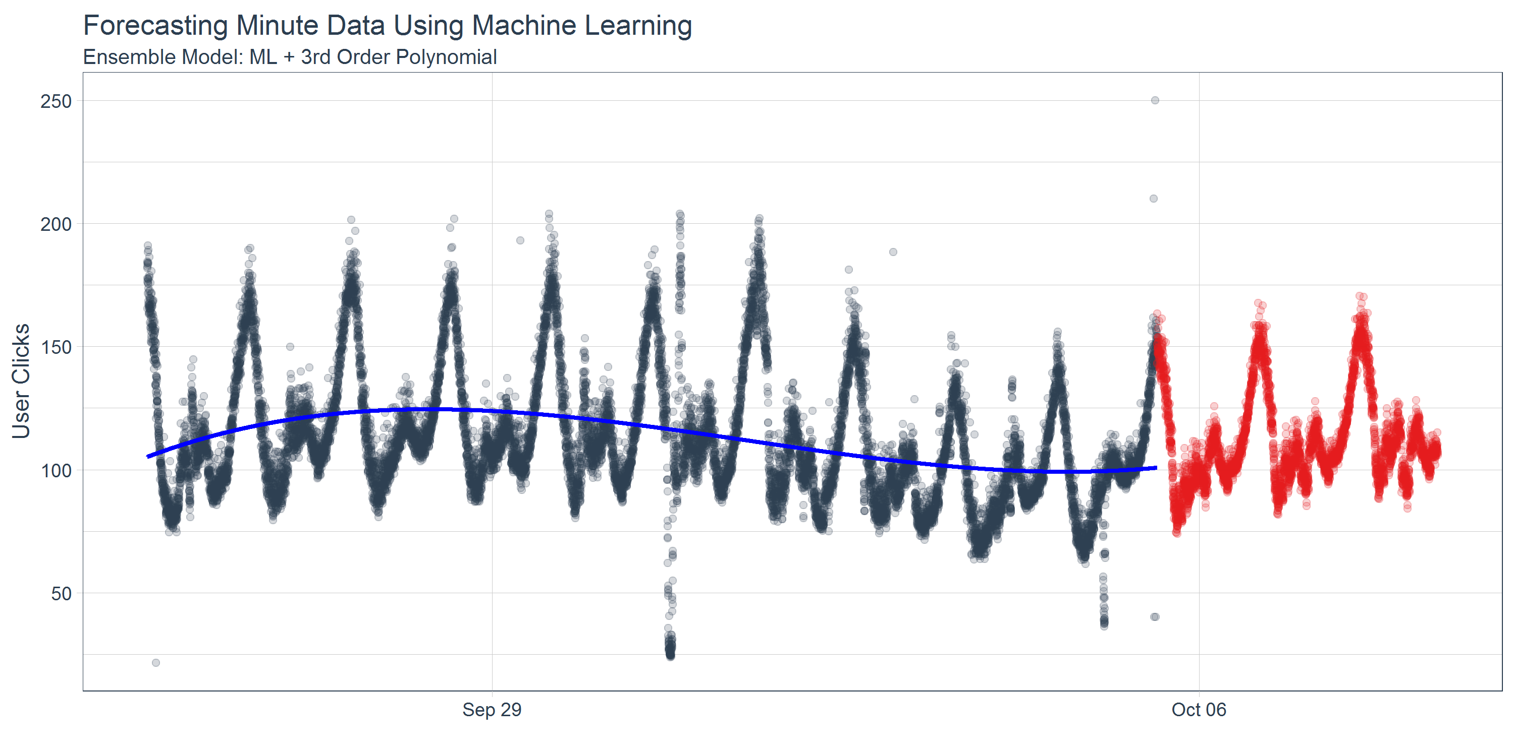
timekit 3rd attempt: ML + 3rd Order Poly
rmse_train =
10.16
3% better
than ML only
3rd order polynomial gets trend

Slide 25
Results
Pros
High frequency (sub-daily)
Pattern detection
Open box
Linear Regression
Decision Tree
Random Forest
GBM
Neural Network
External predictors
Fast performance
Cons
Data science knowledge required
Trend detection

Slide 26
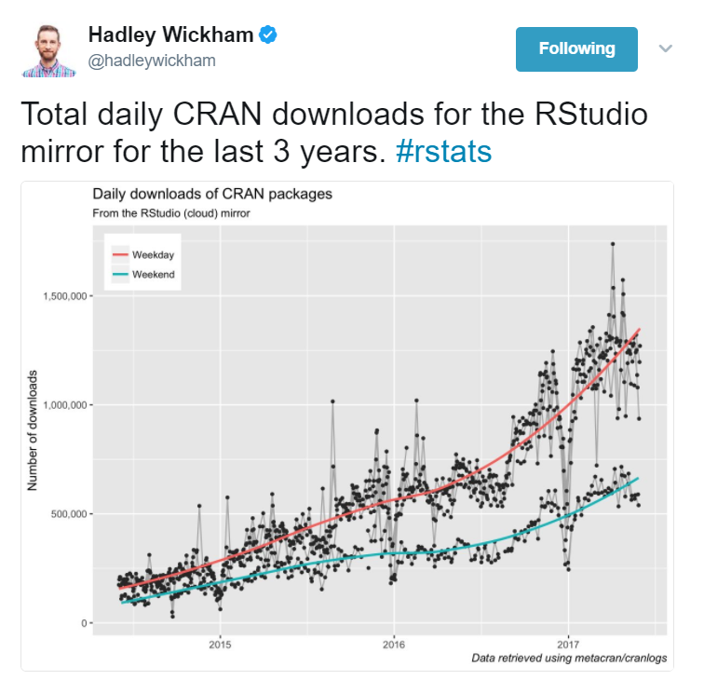
Forecasting CRAN downloads

Slide 27
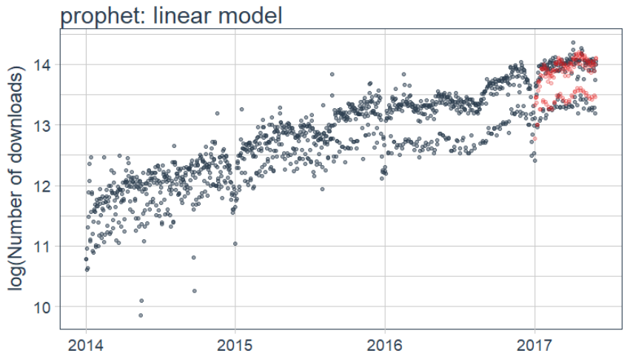
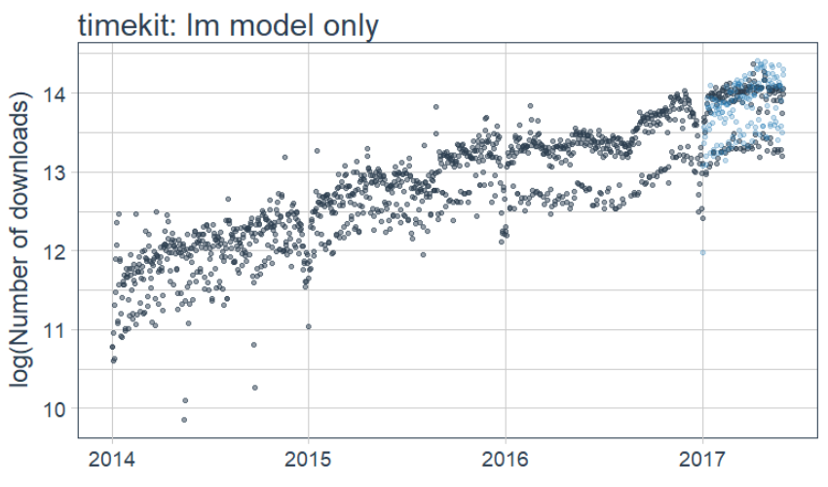
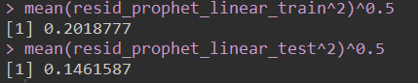
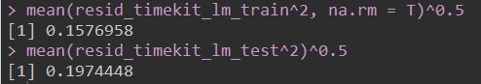
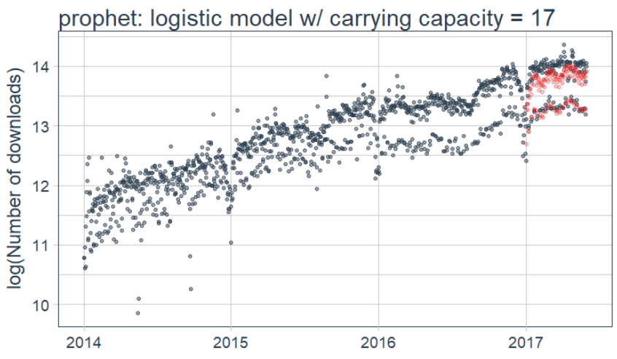
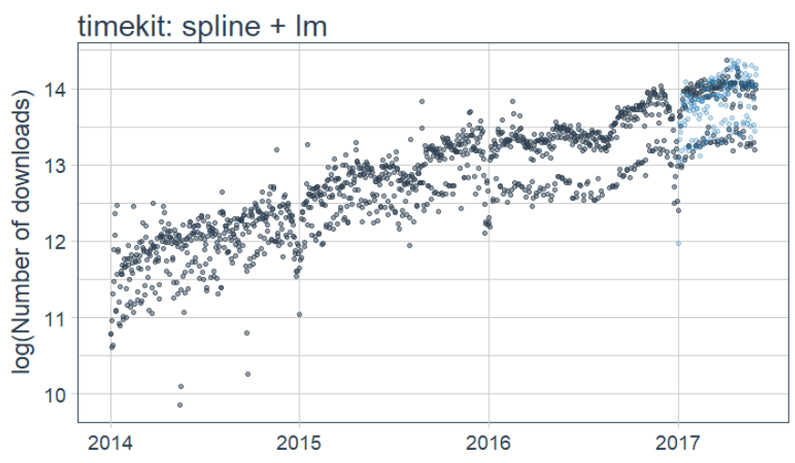
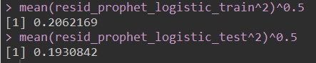
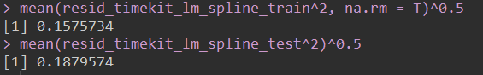
Forecasting CRAN Downloads

Slide 28
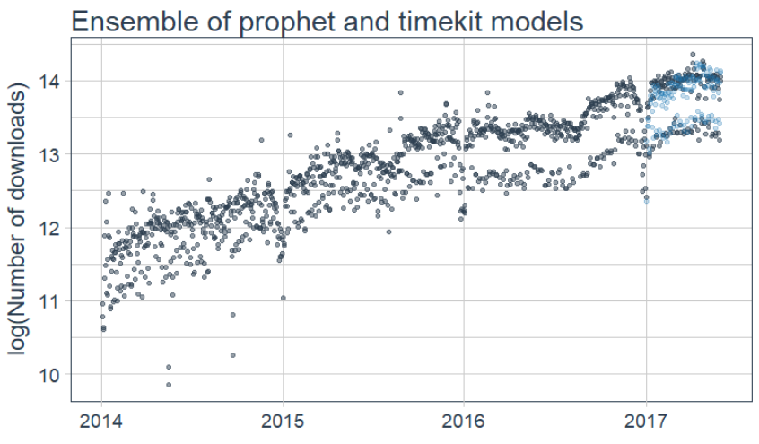
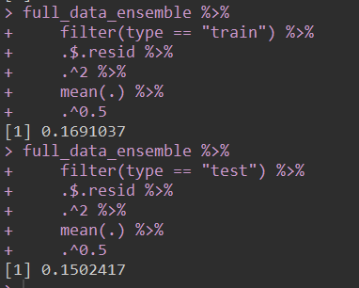
Forecasting CRAN downloads

Slide 29
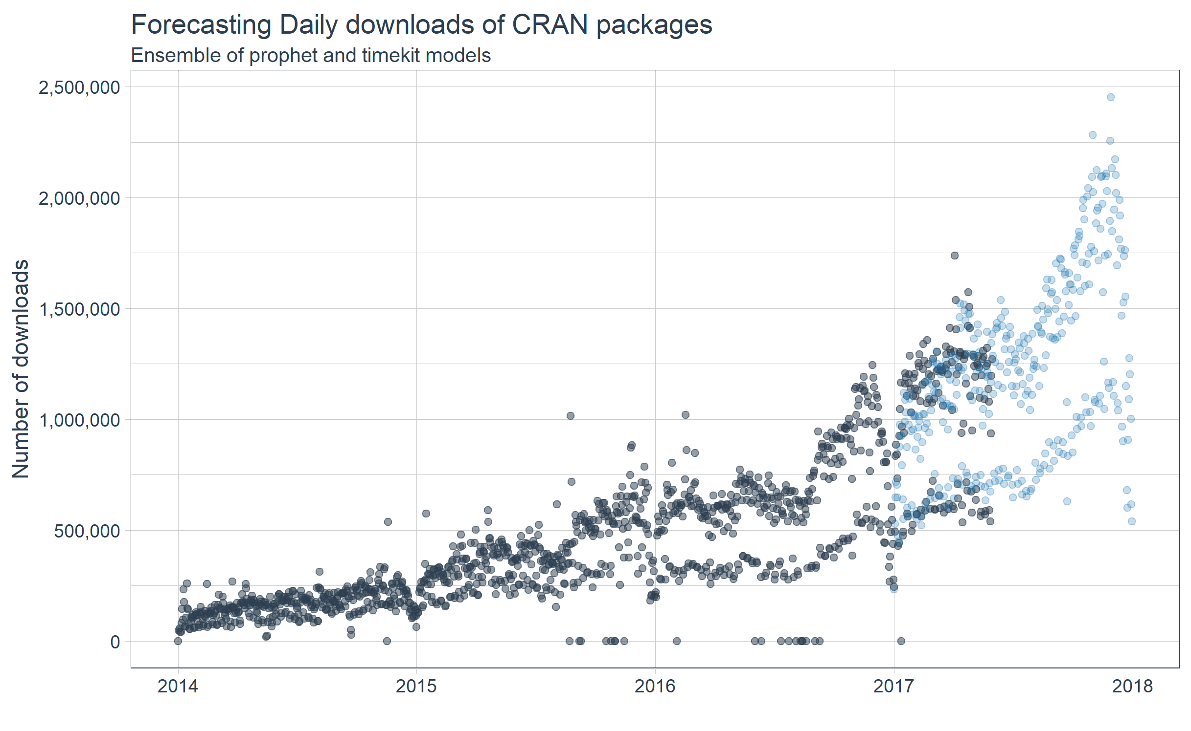
prophet + timekit: Best of both worlds
prophet: excellent for trend
timekit: excellent for patterns

Slide 30
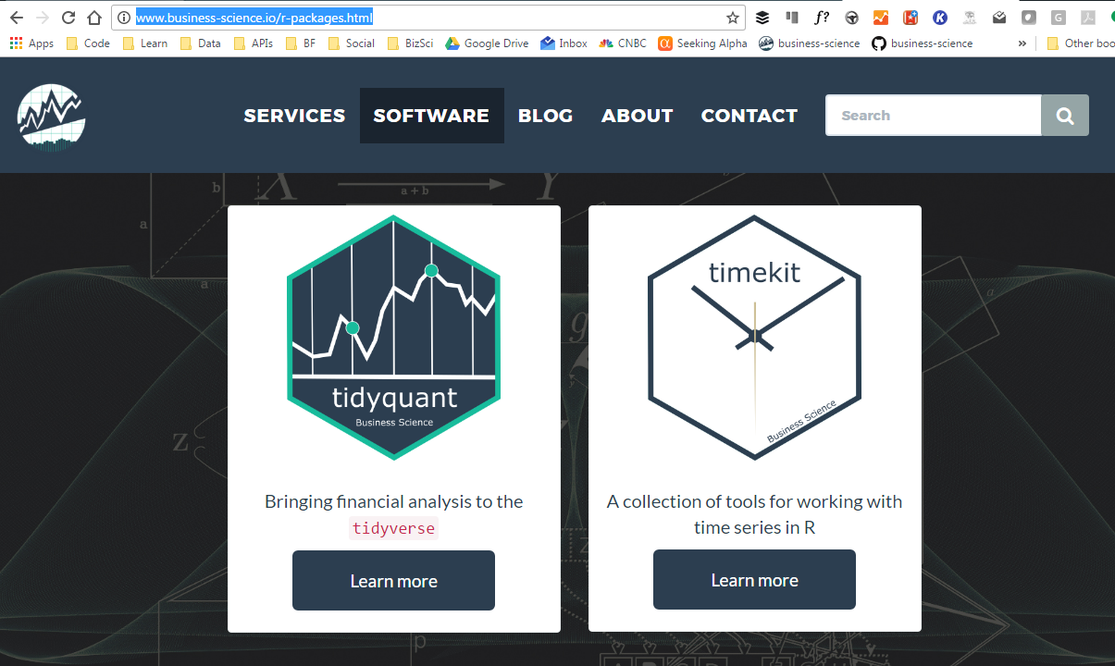
Resources
http://www.business-science.io/r-packages.html
https://github.com/business-science

Slide 31
Act 3: Enterprise Applications
Industry feedback: What we learned
Business Science: What we do
Examples: How we help enterprises

Slide 32
Industry feedback
Most enterprises are not fully utilizing
data science.
Why?

Slide 33
Industry feedback
Data scientists are at a premium
IT departments are backlogged
Consulting is difficult for enterprises
Contracts are time consuming
Limited history on consultants
Companies want security

Slide 34
What we do
Data science on demand
Network of data scientists
Provide all the data science you need
IT on demand
Network of IT professionals
No more backlog
Reduce project lead time
One contract, and you’re set!
Consulting at scale
Optional maintenance agreements = Security
We pull together the right team to get your custom projects done on time, within budget, and of the highest quality.

Slide 35
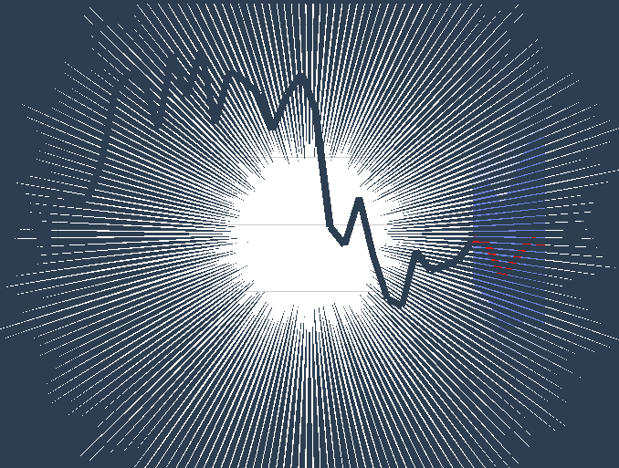

How we help
Data science experts
Advanced forecast
Causal impact
Financial analytics
Anomaly detection
Optimization
Machine learning
Predictive analytics

Slide 36





How we help
Back End | Data Science | Front End

Slide 37
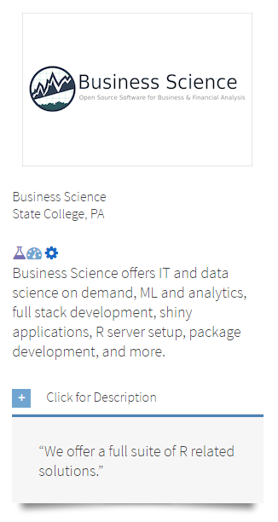
How we help
We handle everything that’s non-core to your business
Model deployment
Package validation & testing
Code optimization (Rcpp & Parallel Processing)
RStudio Server & Shiny Server setup
Version control setup
RStudio partner
https://www.rstudio.com/instructors/

Slide 38
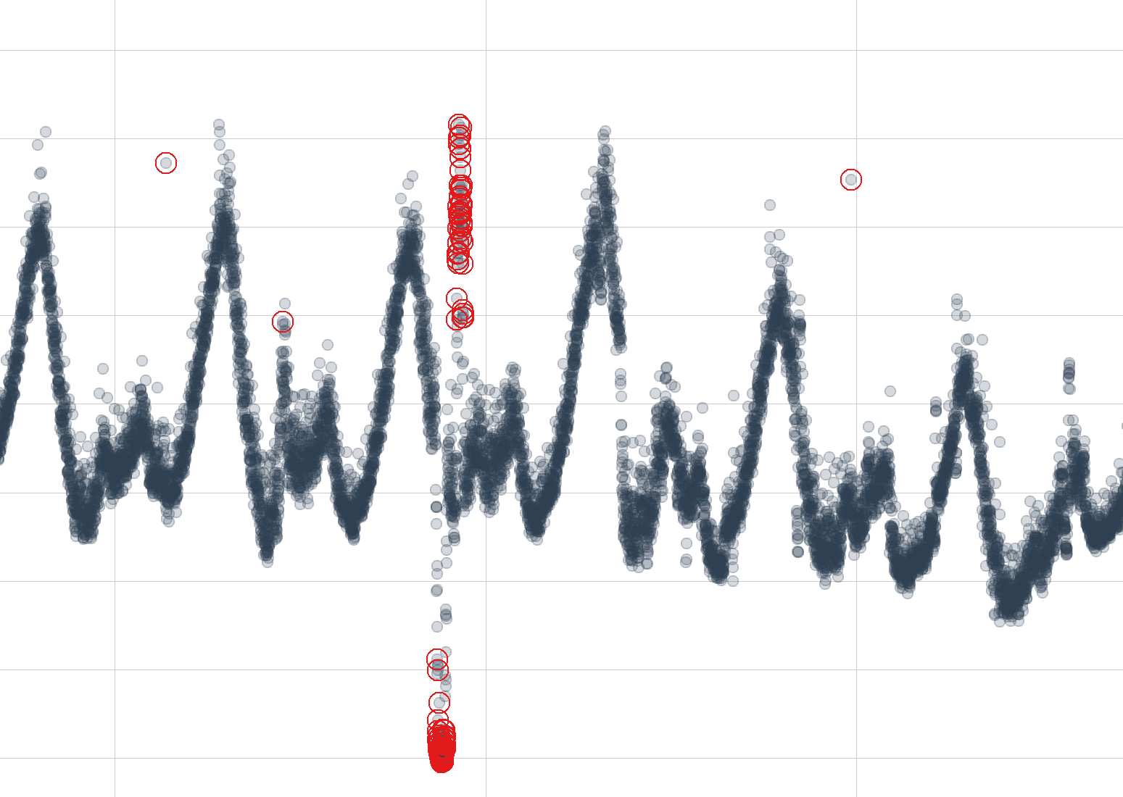
Case studies
Anomaly Detection
Case Study 1
Immediately alerted to model breakdowns
Detect issues before they become problems
SMS / email to alert analysts
Shiny dashboard to visualize metrics

Slide 39
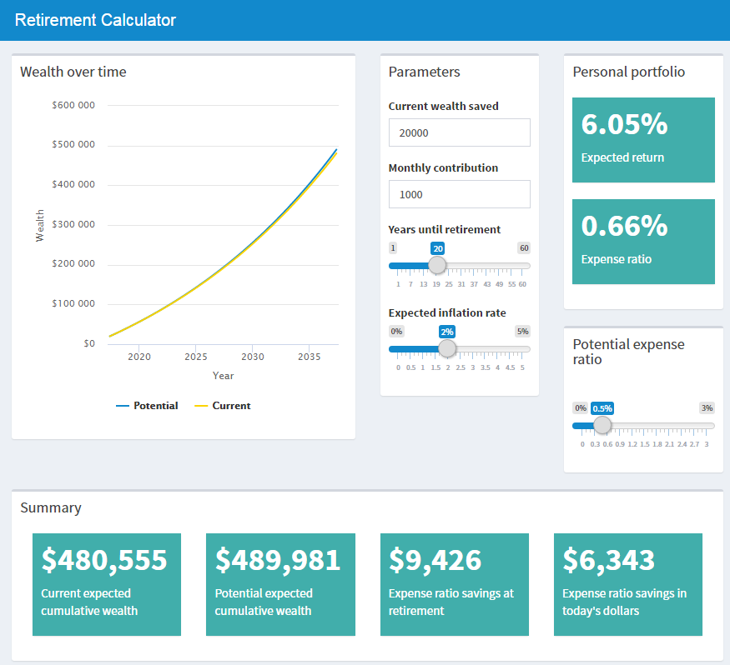

Case studies
Web Apps
Case Study 2
Suite of Shiny dashboards
Customer facing, surface & granular
Expense ratio transparency
Visualize 401K wealth metrics
Charts updated with unique user data
HealthyHiveTM demo

Slide 40
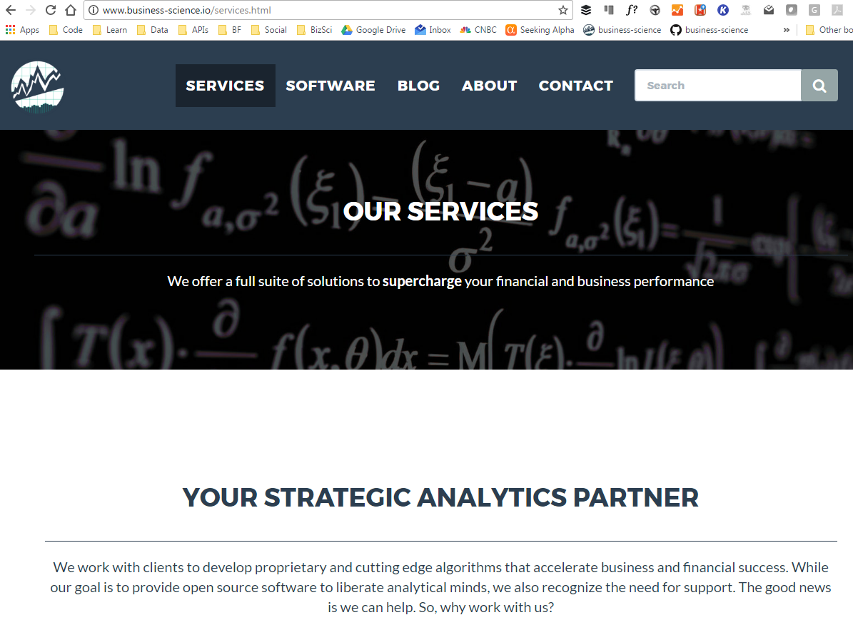
Resources
http://www.business-science.io/services.html

Slide 41
Interested in data science? Contact Business Science!
Business Science www.business-science.io @bizScienc
Matt Dancho Founder, Director of Product Development mdancho@business-science.io
Davis Vaughan Software Engineer dvaughan@business-science.io
@bizScienc
www.business-science.io

